Slide 1
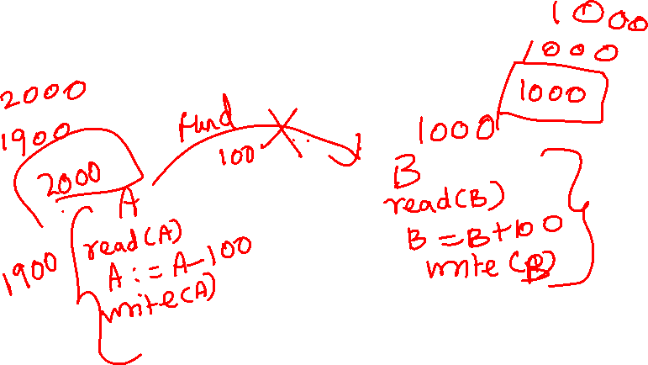
Transactions
Dr. M. Brindha
Assistant Professor
Department of CSE
NIT, Trichy-15

Slide 2
Transaction Concept
A transaction is a unit of program execution that accesses and possibly updates various data items.
A transaction must see a consistent database.
During transaction execution the database may be inconsistent.
When the transaction is committed, the database must be consistent.
Two main issues to deal with:
Failures of various kinds, such as hardware failures and system crashes
Concurrent execution of multiple transactions

Slide 3
ACID Properties
To preserve integrity of data, the database system must ensure:
Atomicity. Either all operations of the transaction are properly reflected in the database or none are.
Consistency. Execution of a transaction in isolation preserves the consistency of the database.
Isolation. Although multiple transactions may execute concurrently, each transaction must be unaware of other concurrently executing transactions. Intermediate transaction results must be hidden from other concurrently executed transactions.
That is, for every pair of transactions T_{i} and T_{j}, it appears to T_{i} that either T_{j}, finished execution before T_{i} started, or T_{j} started execution after T_{i} finished.
Durability. After a transaction completes successfully, the changes it has made to the database persist, even if there are system failures.

Slide 4
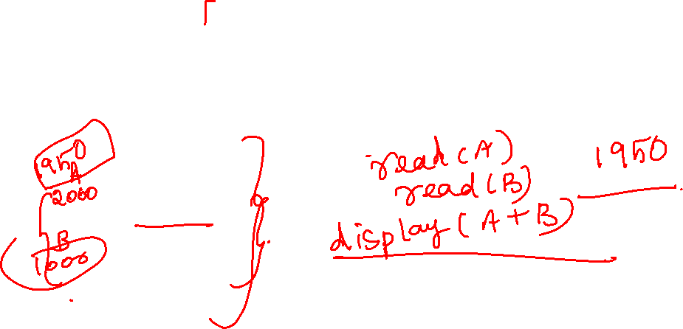
Example of Fund Transfer
Transaction to transfer $50 from account A to account B:
1. read(A)
2. A := A – 50
3. write(A)
4. read(B)
5. B := B + 50
6. write(B)
Consistency requirement – the sum of A and B is unchanged by the execution of the transaction.
Atomicity requirement — if the transaction fails after step 3 and before step 6, the system should ensure that its updates are not reflected in the database, else an inconsistency will result.

Slide 5
Example of Fund Transfer (Cont.)
Durability requirement — once the user has been notified that the transaction has completed (i.e., the transfer of the $50 has taken place), the updates to the database by the transaction must persist despite failures.
Isolation requirement — if between steps 3 and 6, another transaction is allowed to access the partially updated database, it will see an inconsistent database (the sum A + B will be less than it should be). Can be ensured trivially by running transactions serially, that is one after the other. However, executing multiple transactions concurrently has significant benefits, as we will see.

Slide 6
Transaction State
Active, the initial state; the transaction stays in this state while it is executing
Partially committed, after the final statement has been executed.
Failed, after the discovery that normal execution can no longer proceed.
Aborted, after the transaction has been rolled back and the database restored to its state prior to the start of the transaction. Two options after it has been aborted:
restart the transaction – only if no internal logical error
kill the transaction
Committed, after successful completion.

Slide 7
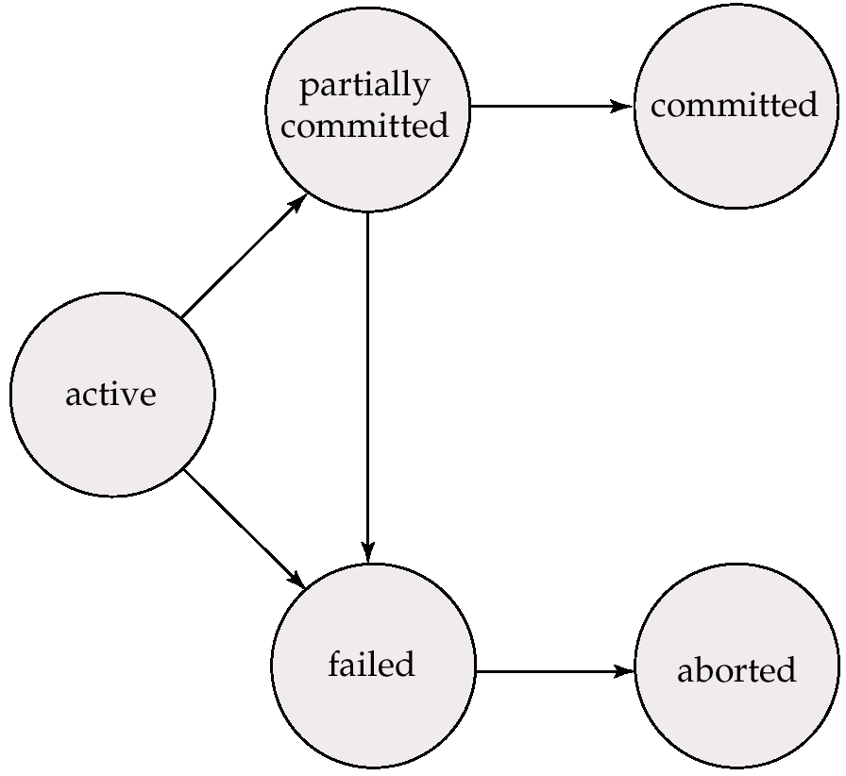
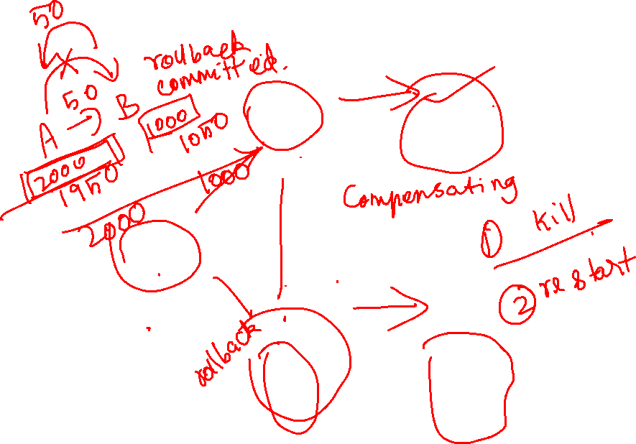
Transaction State (Cont.)

Slide 8

Implementation of Atomicity and Durability
The recovery-management component of a database system implements the support for atomicity and durability.
The shadow-database scheme:
assume that only one transaction is active at a time.
a pointer called db_pointer always points to the current consistent copy of the database.
all updates are made on a shadow copy of the database, and db_pointer is made to point to the updated shadow copy only after the transaction reaches partial commit and all updated pages have been flushed to disk.
in case transaction fails, old consistent copy pointed to by db_pointer can be used, and the shadow copy can be deleted.

Slide 9
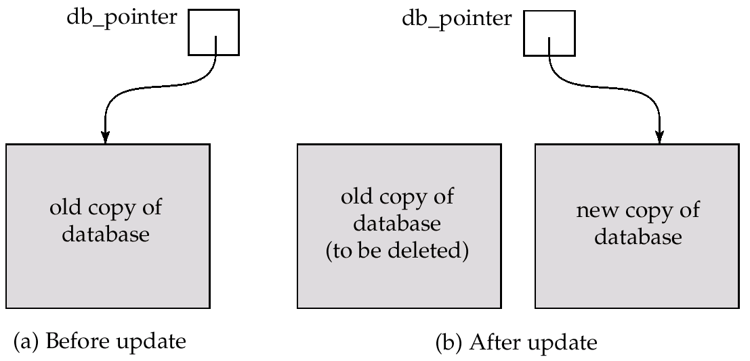

Implementation of Atomicity and Durability (Cont.)
The shadow-database scheme:
Assumes disks to not fail
Useful for text editors, but extremely inefficient for large databases: executing a single transaction requires copying the entire database.

Slide 10
Concurrent Executions
Multiple transactions are allowed to run concurrently in the system. Advantages are:
increased processor and disk utilization, leading to better transaction throughput: one transaction can be using the CPU while another is reading from or writing to the disk
reduced average response time for transactions: short transactions need not wait behind long ones.
Concurrency control schemes – mechanisms to achieve isolation, i.e., to control the interaction among the concurrent transactions in order to prevent them from destroying the consistency of the database

Slide 11
Schedules
Schedules – sequences that indicate the chronological order in which instructions of concurrent transactions are executed
a schedule for a set of transactions must consist of all instructions of those transactions
must preserve the order in which the instructions appear in each individual transaction.

Slide 12
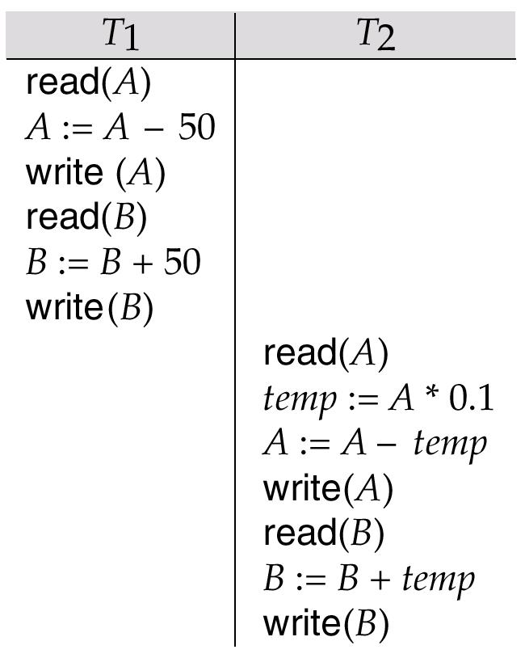
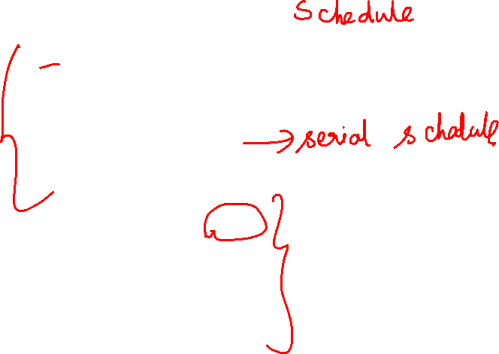
Example Schedules
Let T₁ transfer $50 from A to B, and T₂ transfer 10% of the balance from A to B. The following is a serial schedule (Schedule 1 in the text), in which T₁ is followed by T₂.

Slide 13
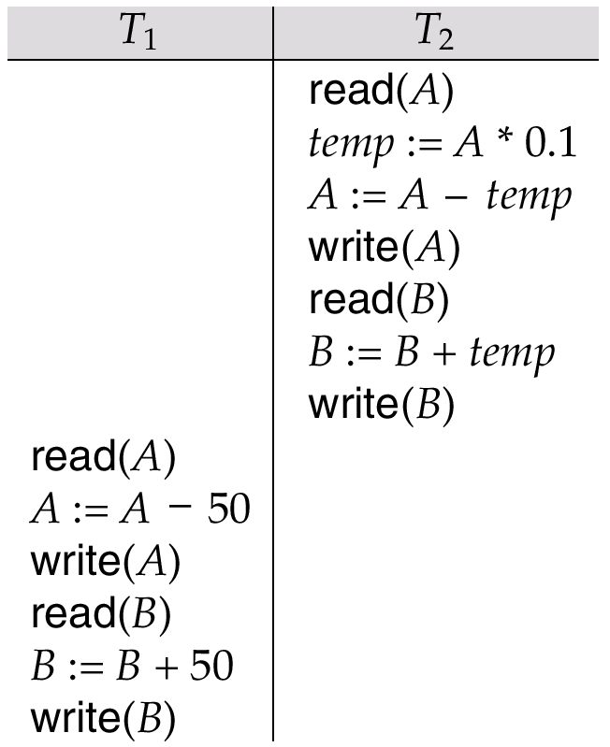
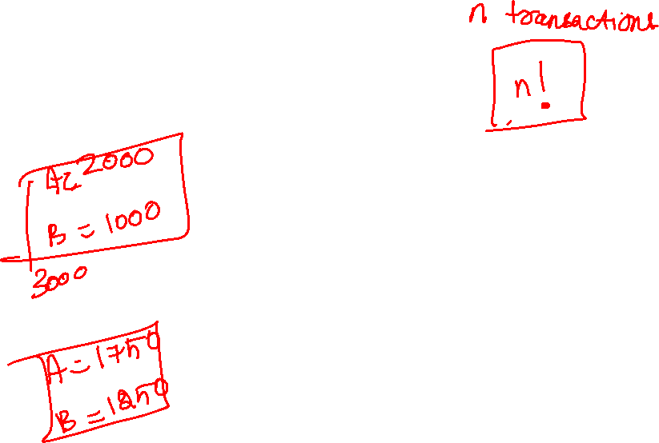
Schedule 2 -- A Serial Schedule in Which T₂ is Followed by T₁

Slide 14
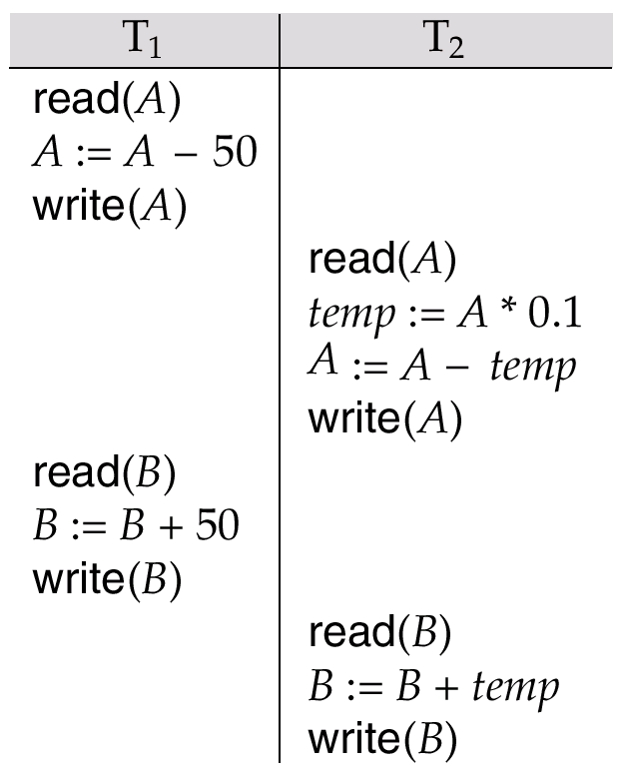


Example Schedule (Cont.)
Let T₁ and T₂ be the transactions defined previously. The following schedule (Schedule 3 in the text) is not a serial schedule, but it is equivalent to Schedule 1.
In both Schedule 1 and 3, the sum A + B is preserved.

Slide 15
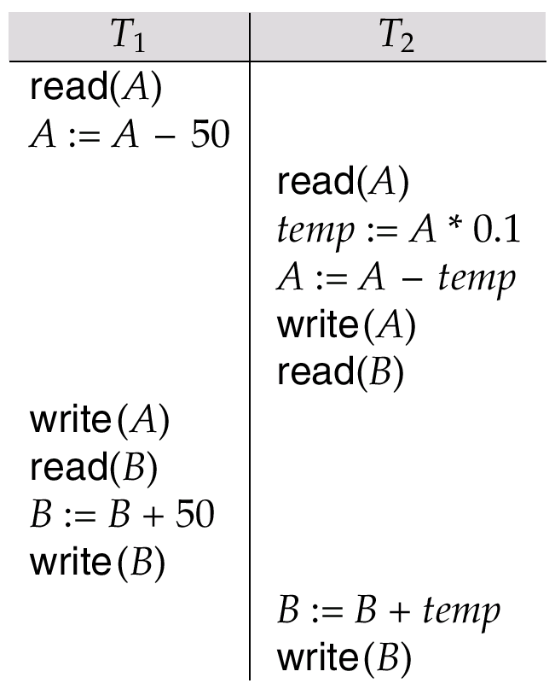
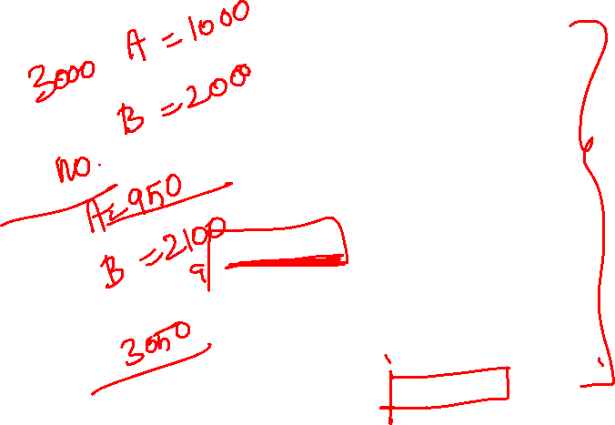
Example Schedules (Cont.)
The following concurrent schedule (Schedule 4 in the text) does not preserve the value of the sum A + B.

Slide 16
Serializability
Basic Assumption – Each transaction preserves database consistency.
Thus serial execution of a set of transactions preserves database consistency.
A (possibly concurrent) schedule is serializable if it is equivalent to a serial schedule. Different forms of schedule equivalence give rise to the notions of:
1. conflict serializability
2. view serializability
We ignore operations other than read and write instructions, and we assume that transactions may perform arbitrary computations on data in local buffers in between reads and writes. Our simplified schedules consist of only read and write instructions.

Slide 17
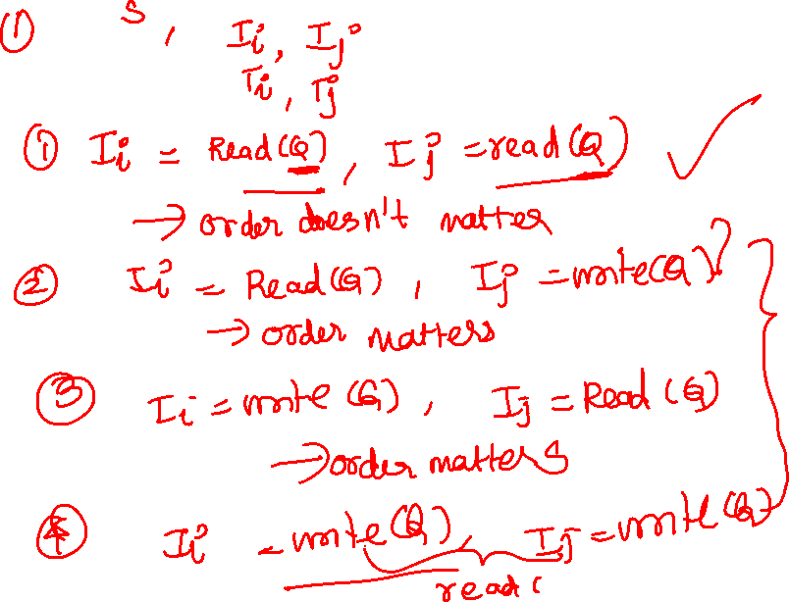

Slide 18
Conflict Serializability
Instructions l_{i} and l_{j} of transactions T_{i} and T_{j} respectively, conflict if and only if there exists some item Q accessed by both l_{i} and l_{j}, and at least one of these instructions wrote Q.
1. l_{i} = read(Q), l_{j} = read(Q). l_{i} and l_{j} don’t conflict.
2. l_{i} = read(Q), l_{j} = write(Q). They conflict.
3. l_{i} = write(Q), l_{j} = read(Q). They conflict
4. l_{i} = write(Q), l_{j} = write(Q). They conflict
Intuitively, a conflict between l_{i} and l_{j} forces a (logical) temporal order between them. If l_{i} and l_{j} are consecutive in a schedule and they do not conflict, their results would remain the same even if they had been interchanged in the schedule.

Slide 19
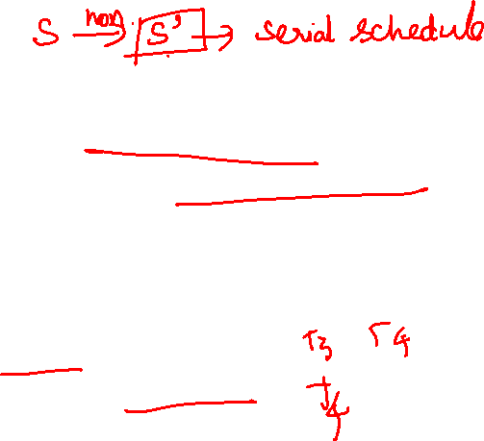
Conflict Serializability (Cont.)
If a schedule S can be transformed into a schedule S´ by a series of swaps of non-conflicting instructions, we say that S and S´ are conflict equivalent.
We say that a schedule S is conflict serializable if it is conflict equivalent to a serial schedule
Example of a schedule that is not conflict serializable:
T₃ T₄ read(Q) write(Q) write(Q)
We are unable to swap instructions in the above schedule to obtain either the serial schedule < T₃, T₄ >, or the serial schedule < T₄, T₃ >.

Slide 20
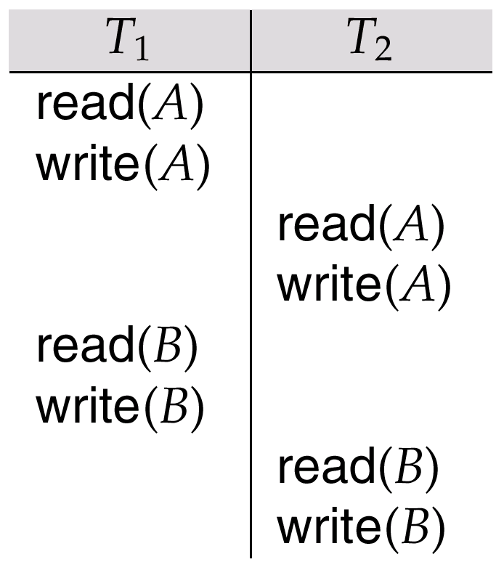
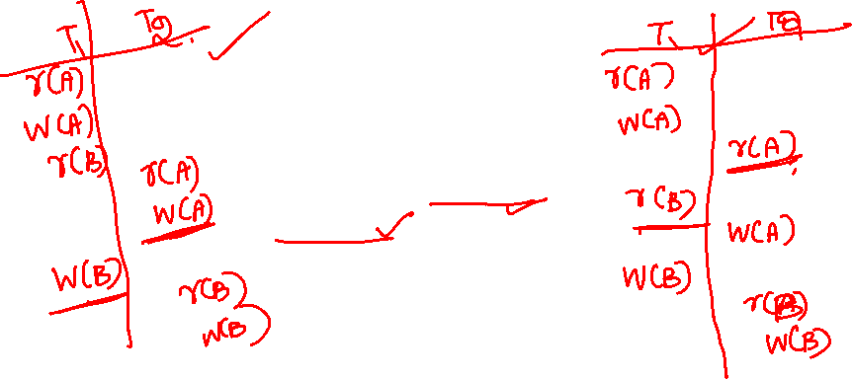
Conflict Serializability (Cont.)
Schedule 3 below can be transformed into Schedule 1, a serial schedule where T₂ follows T₁, by series of swaps of non-conflicting instructions. Therefore Schedule 3 is conflict serializable.

Slide 21
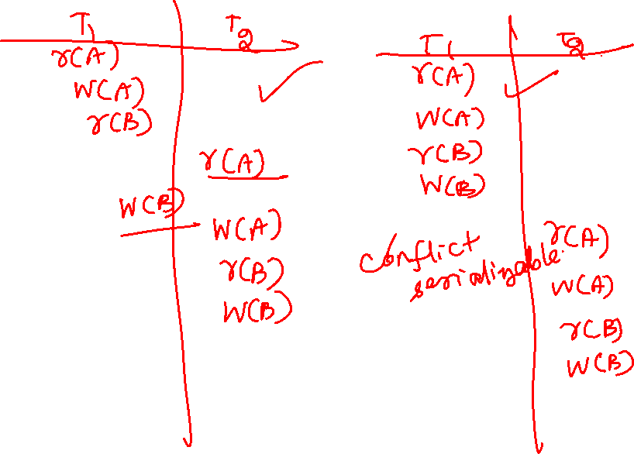

Slide 23
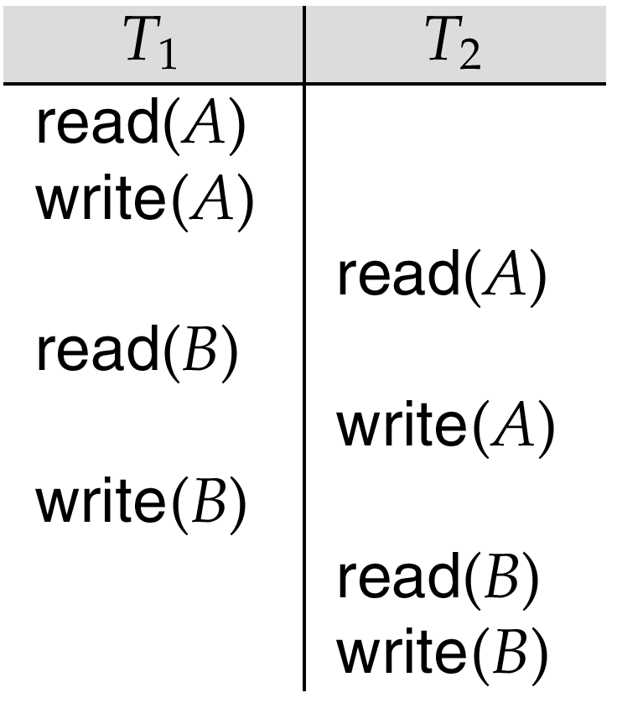
Schedule 5 -- Schedule 3 After Swapping A Pair of Instructions

Slide 24
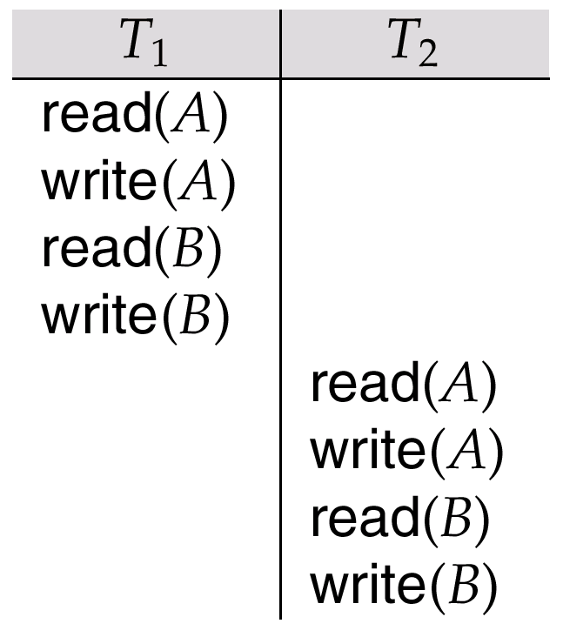
Schedule 6 -- A Serial Schedule That is Equivalent to Schedule 3

Slide 25
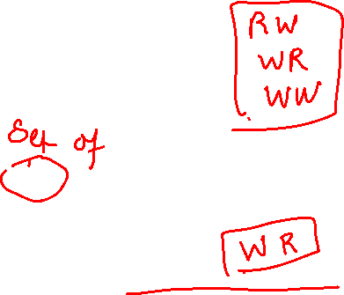
View Serializability
Let S and S´ be two schedules with the same set of transactions. S and S´ are view equivalent if the following three conditions are met:
1. For each data item Q, if transaction T_{i} reads the initial value of Q in schedule S, then transaction T_{i} must, in schedule S´, also read the initial value of Q.
2. For each data item Q if transaction T_{i} executes read(Q) in schedule S, and that value was produced by transaction T_{j} (if any), then transaction T_{i} must in schedule S´ also read the value of Q that was produced by transaction T_{j} .
3. For each data item Q, the transaction (if any) that performs the final write(Q) operation in schedule S must perform the final write(Q) operation in schedule S´.
As can be seen, view equivalence is also based purely on reads
and writes alone.

Slide 26
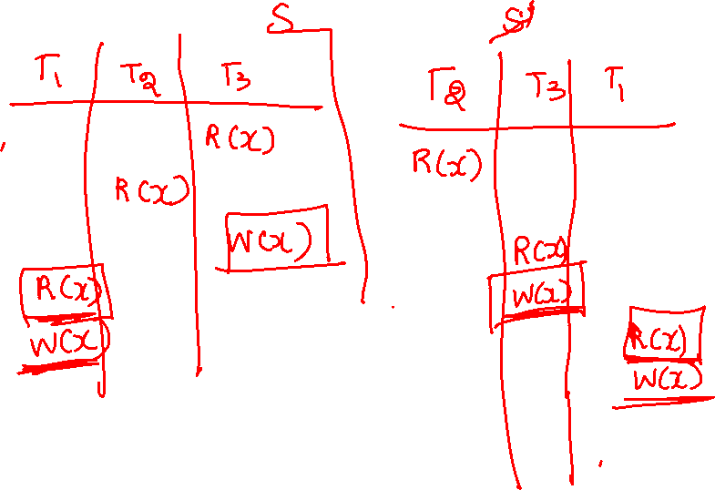

Slide 27
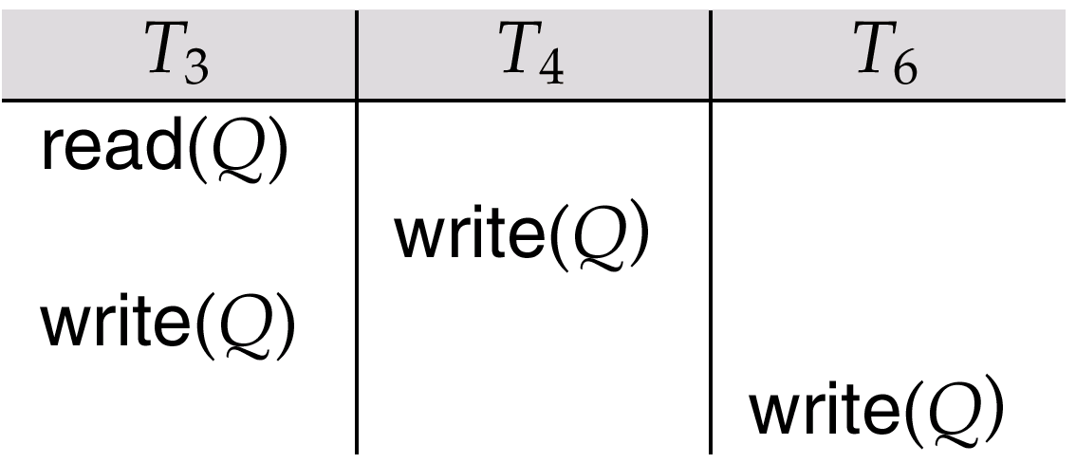
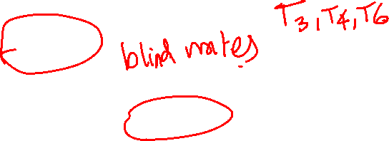
View Serializability (Cont.)
A schedule S is view serializable it is view equivalent to a serial schedule.
Every conflict serializable schedule is also view serializable.
Schedule 9 (from text) — a schedule which is view-serializable but not conflict serializable.
Every view serializable schedule that is not conflict serializable has blind writes.

Slide 28
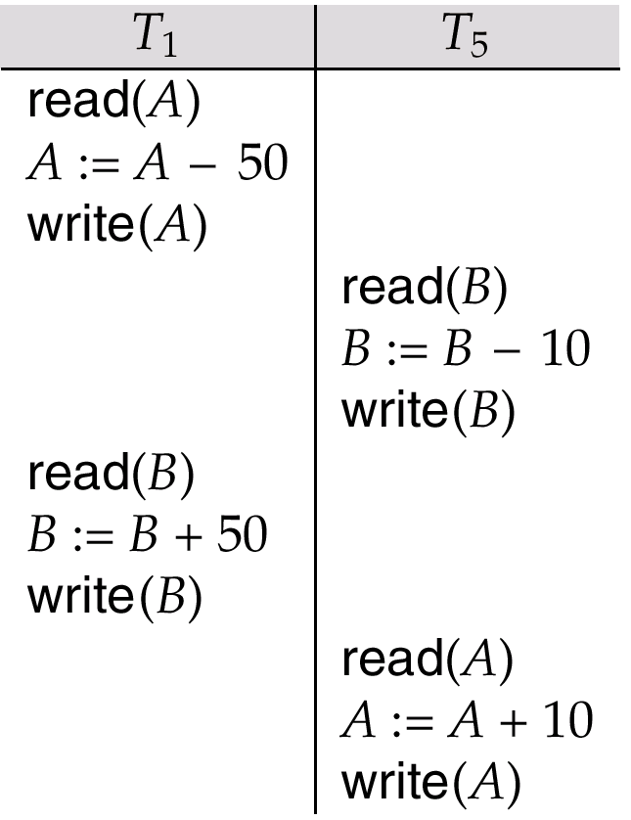

Other Notions of Serializability
Schedule 8 (from text) given below produces same outcome as the serial schedule < T₁, T₅ >, yet is not conflict equivalent or view equivalent to it.
Determining such equivalence requires analysis of operations other than read and write.

Slide 29
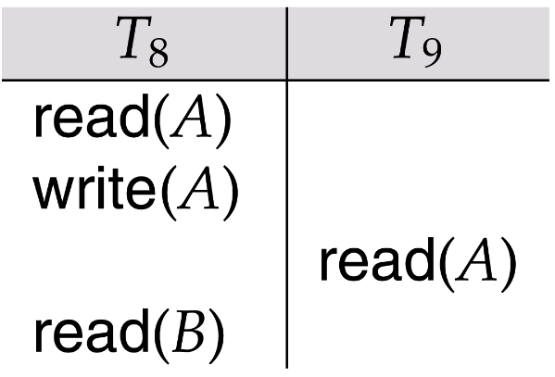
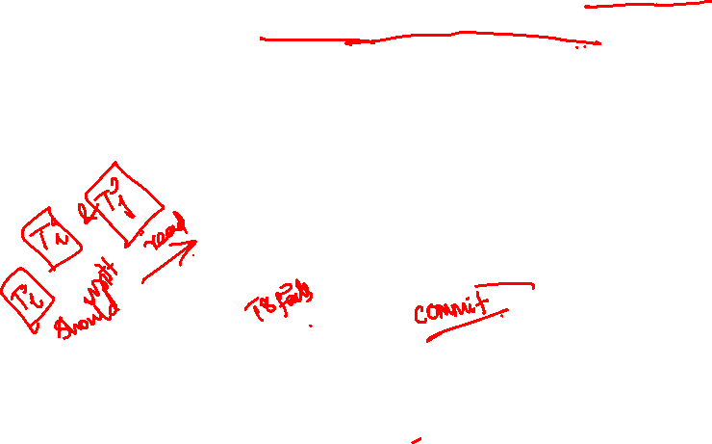
Recoverability
Need to address the effect of transaction failures on concurrently running transactions.
Recoverable schedule — if a transaction T_{j} reads a data items previously written by a transaction T_{i} , the commit operation of T_{i} appears before the commit operation of T_{j}.
The following schedule (Schedule 11) is not recoverable if T₉ commits immediately after the read
If T₈ should abort, T₉ would have read (and possibly shown to the user) an inconsistent database state. Hence database must ensure that schedules are recoverable.

Slide 30
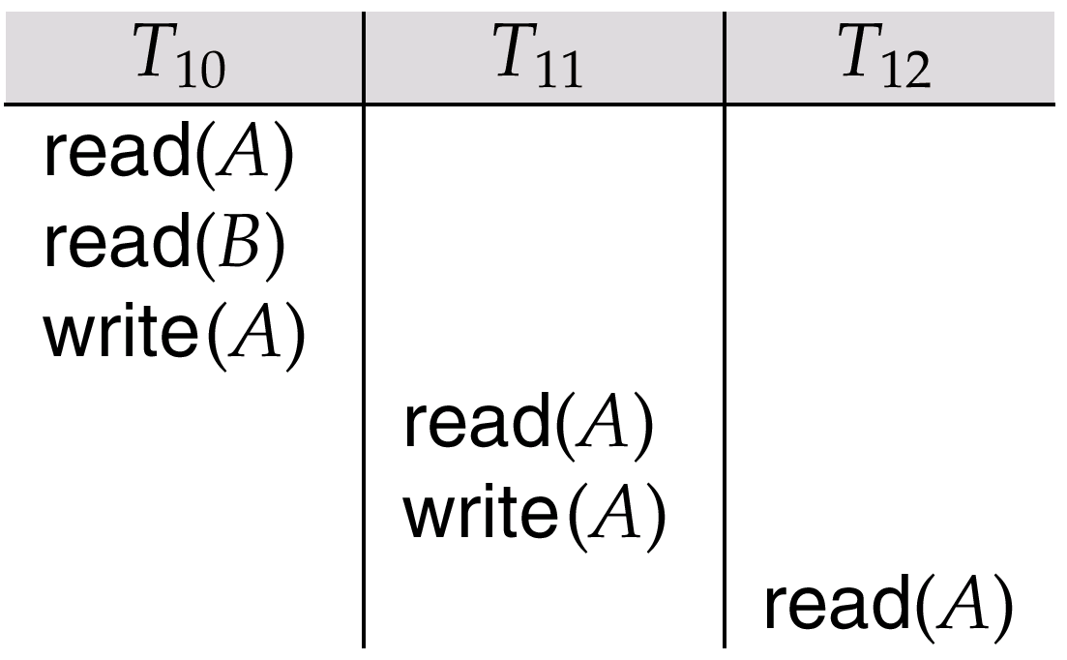
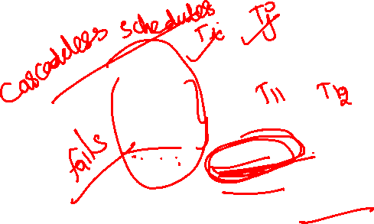
Recoverability (Cont.)
Cascading rollback – a single transaction failure leads to a series of transaction rollbacks. Consider the following schedule where none of the transactions has yet committed (so the schedule is recoverable) If T₁₀ fails, T₁₁ and T₁₂ must also be rolled back.
Can lead to the undoing of a significant amount of work

Slide 31
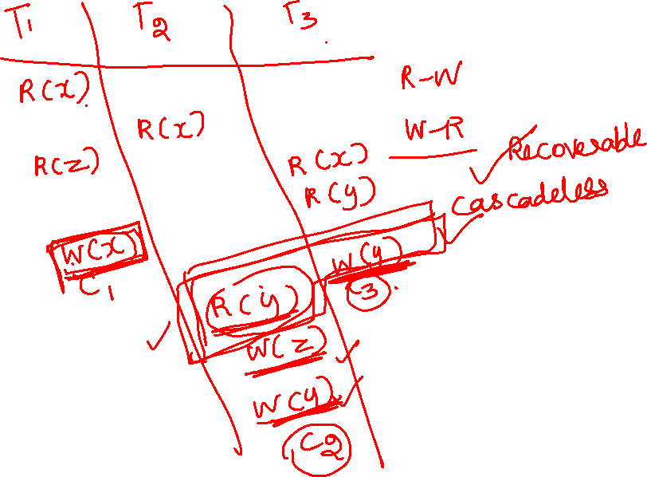

Slide 33
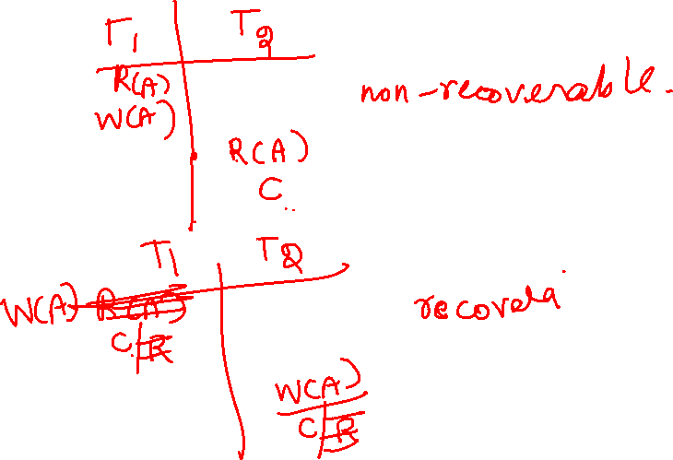

Slide 34
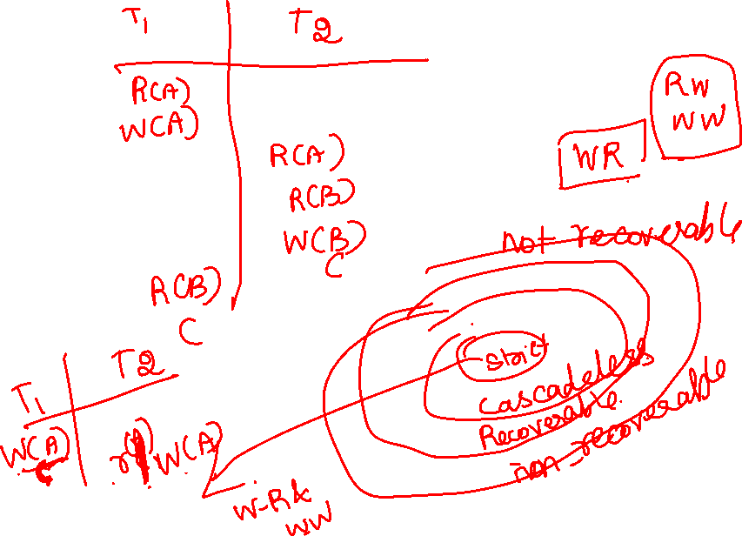

Slide 35
Recoverability (Cont.)
Cascadeless schedules — cascading rollbacks cannot occur; for each pair of transactions T_{i} and T_{j} such that T_{j} reads a data item previously written by T_{i}, the commit operation of T_{i} appears before the read operation of T_{j}.
Every cascadeless schedule is also recoverable
It is desirable to restrict the schedules to those that are cascadeless

Slide 36
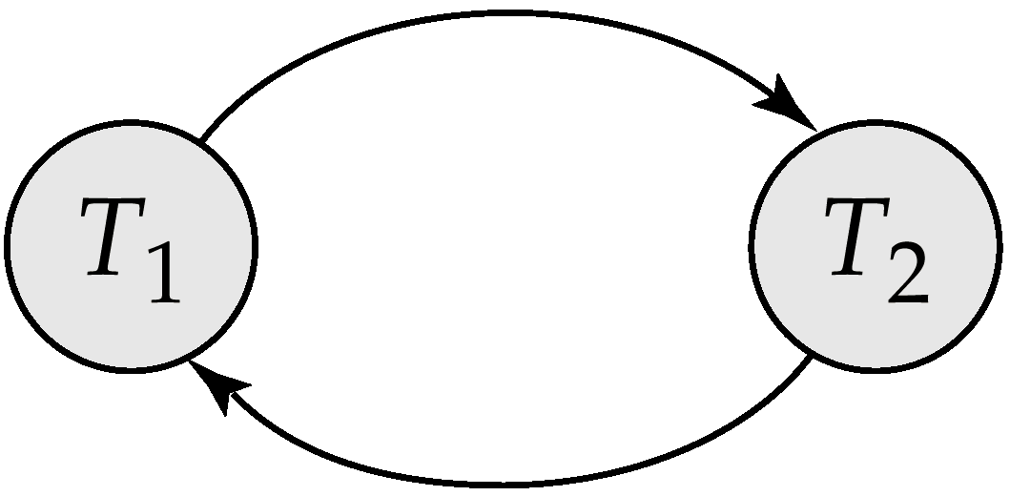
Testing for Serializability
Consider some schedule of a set of transactions T₁, T₂, ..., T_{n}
Precedence graph — a direct graph where the vertices are the transactions (names).
We draw an arc from T_{i} to T_{j} if the two transaction conflict, and T_{i} accessed the data item on which the conflict arose earlier.
We may label the arc by the item that was accessed.
Example 1
x
y

Slide 37
Test for Conflict Serializability
A schedule is conflict serializable if and only if its precedence graph is acyclic.
Cycle-detection algorithms exist which take order n² time, where n is the number of vertices in the graph. (Better algorithms take order n + e where e is the number of edges.)
If precedence graph is acyclic, the serializability order can be obtained by a topological sorting of the graph. This is a linear order consistent with the partial order of the graph.

Slide 38
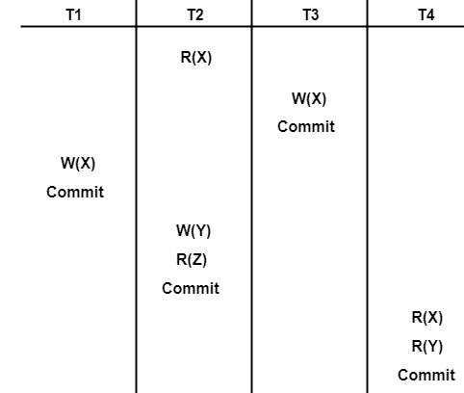
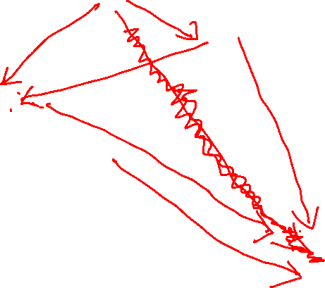
Example Schedule

Slide 39
Example Schedule
List all the conflicting operations and determine the dependency between the transactions-
R₂(X) , W₃(X) (T₂ → T₃)
R₂(X) , W₁(X) (T₂ → T₁)
W₃(X) , W₁(X) (T₃ → T₁)
W₃(X) , R₄(X) (T₃ → T₄)
W₁(X) , R₄(X) (T₁ → T₄)
W₂(Y) , R₄(Y) (T₂ → T₄)

Slide 40
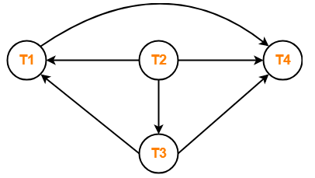
Precedence Graph for Schedule A
T2->T3->T1->T4

Slide 41
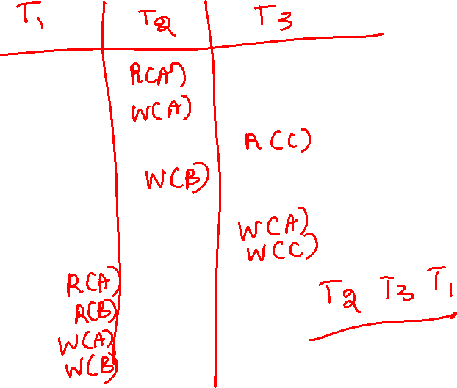

Slide 42

Thank You!!!

